Slide 1
Shark
Preparedness
TOWN OF TRURO
June 2019

Slide 2

2013- Shark Working Group Initiatives
Regional group of staff members from Cape towns (beach officials, harbormasters, natural resource directors, etc.), CCNS, Atlantic White Shark Conservancy and Dr. Greg Skomal of DMF
Group developed uniform procedures for shark sighting, reporting, and swimming closures so that beach patrons would experience uniformity at Cape beaches.
Some of the group’s initiatives include:
    Reaching out to communities around the world regarding their responses to white sharks
    New purple shark flags to indicate a presence of sharks
    Uniform signage
    Uniform shark brochures
    Short informational video about sharks
    Sharktivity app
    Working Group notification system
    Uniform messaging about shark safety
Purple Shark Flag

Slide 3
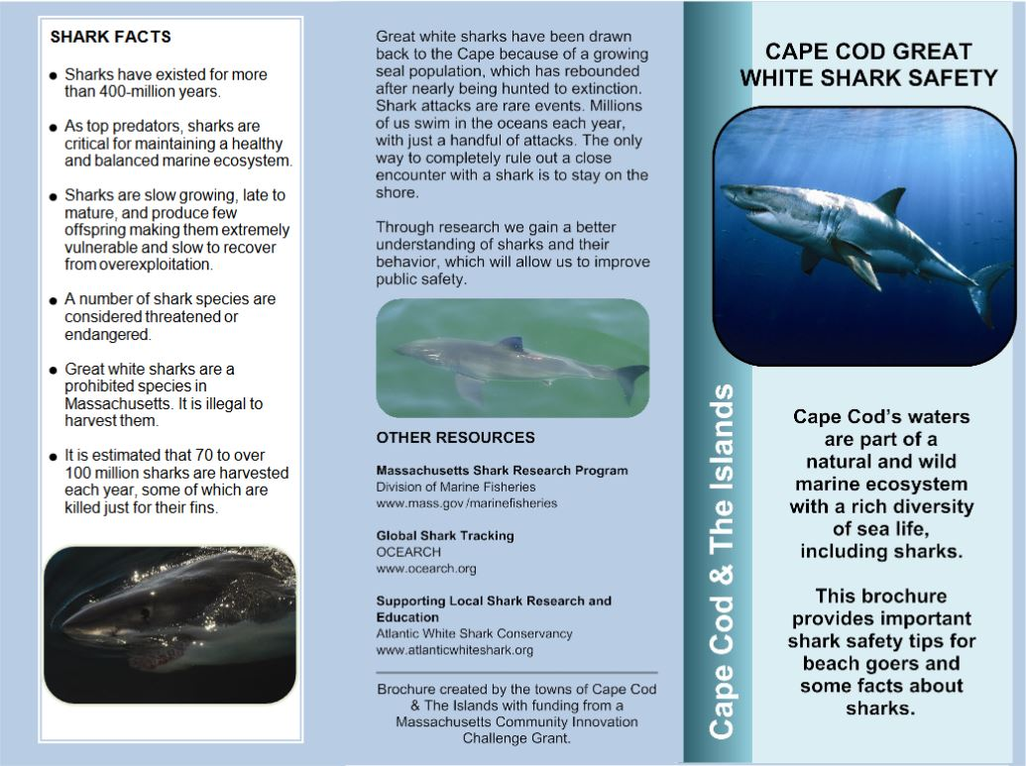
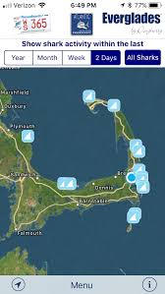
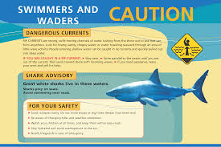
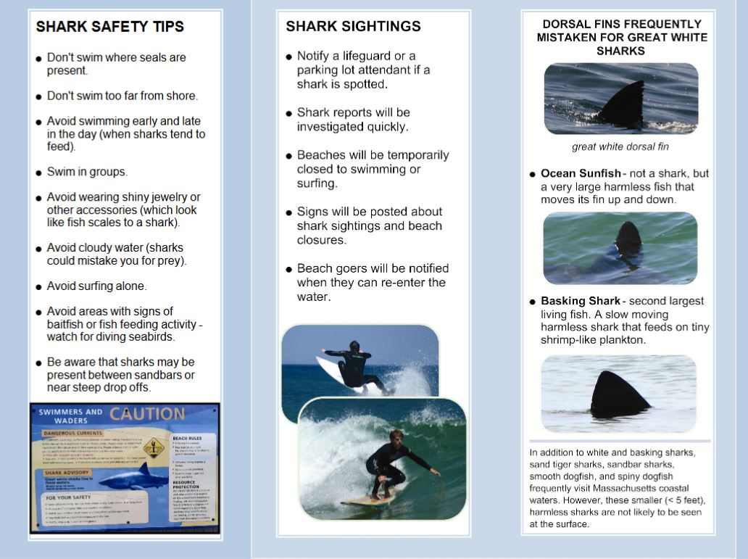
Cape Cod Great White Shark Safety Brochure
Signs Produced in 2013
Sharktivy App
For reported sightings and public notifications

Slide 4
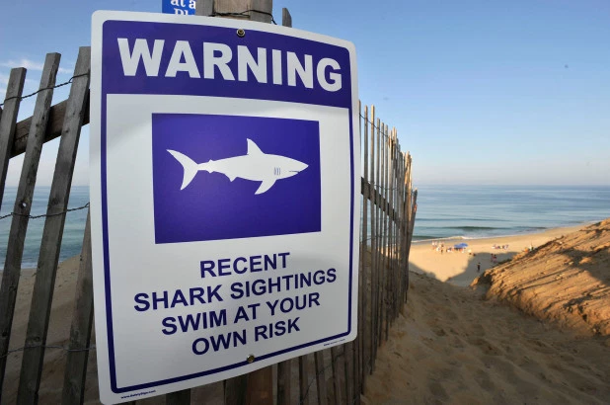
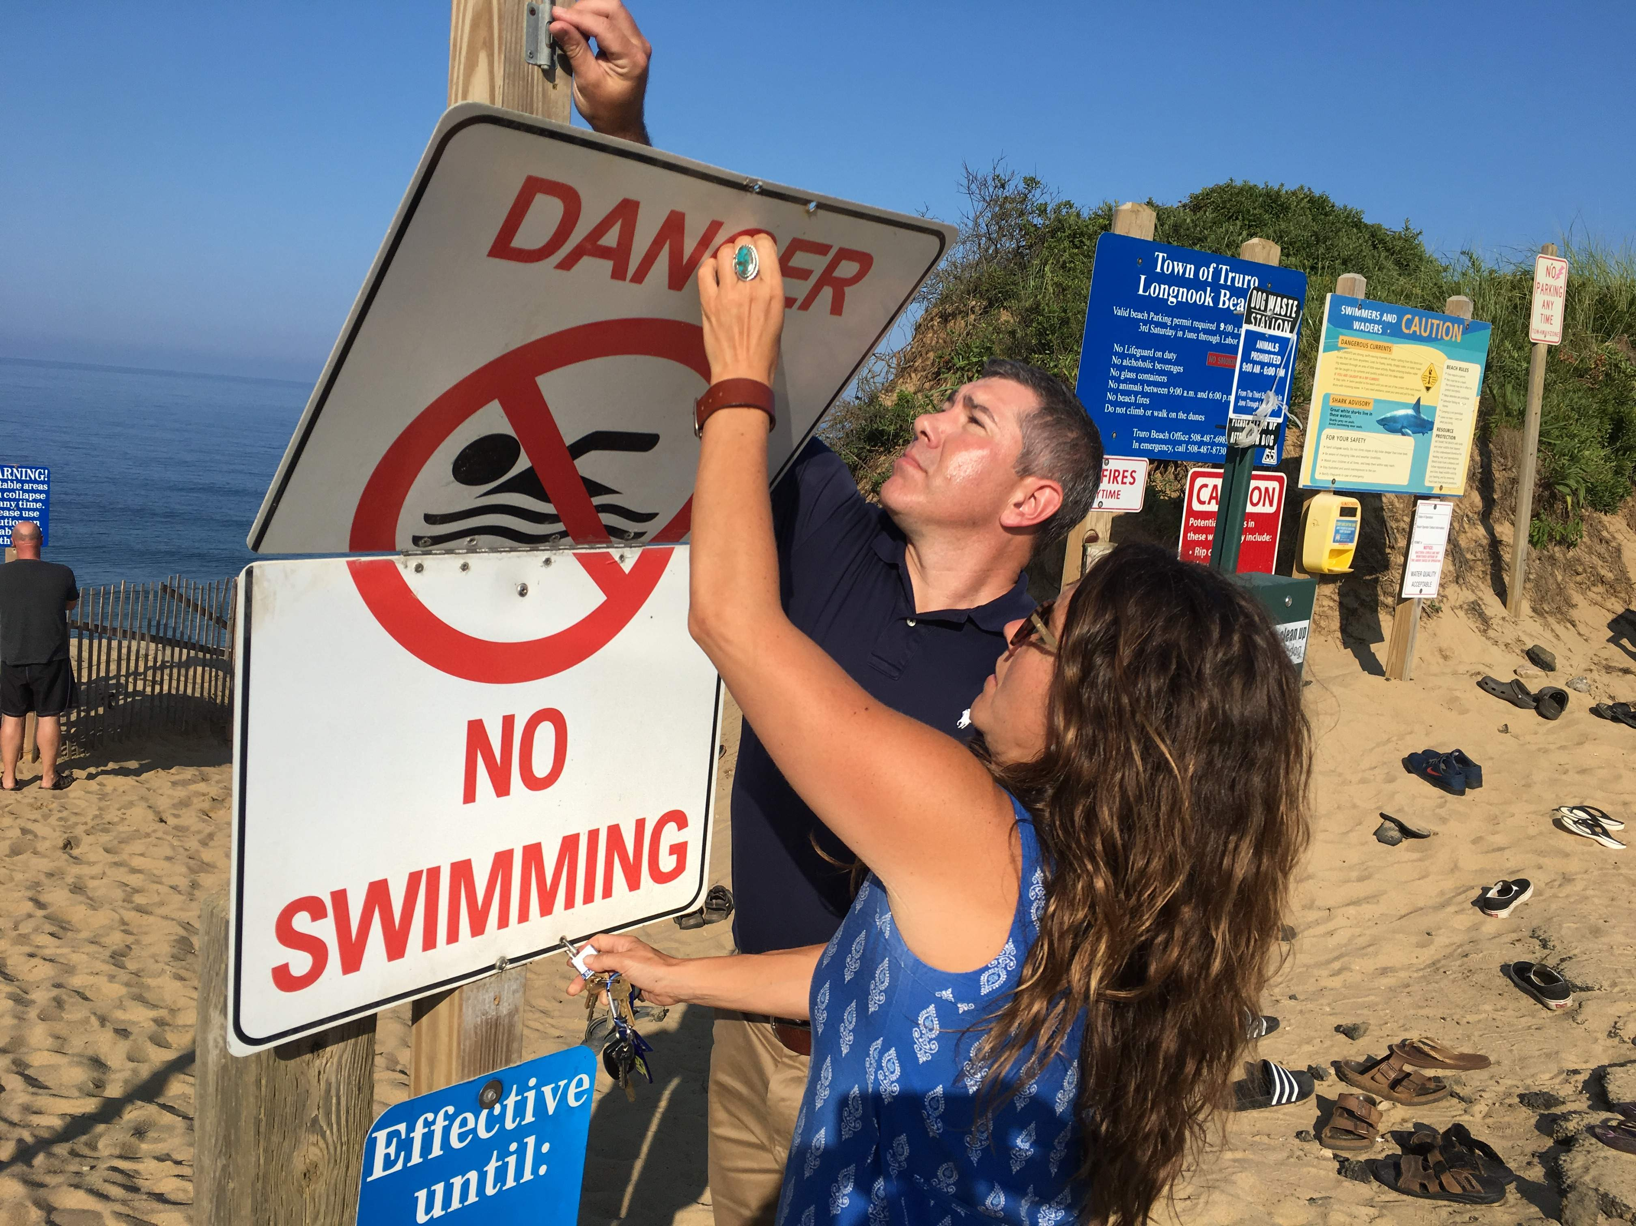
Truro Initiatives
Shark Informational Video included on Town website
Dangerous Marine Life section added to annual beach brochures
Shark Brochures distributed with beach stickers annually and by beach attendants
Cape Cod Times Photo
AP Photo
Hinged Signs to Indicate Swimming Closure
Installed in 2014 at all ocean beaches
Recent Shark Sighting Signs
Installed in 2018 at all ocean beaches

Slide 5
2018- Town Manager/ Administrator Shark Response Group
Managers/ Administrators from six towns in the National Seashore (Chatham, Orleans, Eastham, Wellfleet, Truro and Provincetown) and Superintendent Carlstrom of CCNS began meeting in fall 2018 in response to Wellfleet shark fatality and Truro shark bite.
The group asked for funding for external communications, internal communications, medical response supplies, and public education tools and were granted $383,000.00 by the State for expenditures in FY19. Truro received $144,000 of the funding.
Meetings continue to identify longer term solutions.

Slide 6
Fall 2018- Present Shark Preparedness Efforts
Education/ Information
Public Awareness/ Prevention
Communications
Medical Response
Research

Slide 7
Fall 2018- Present Shark Preparedness Efforts
Education/ Information
        Shark presentation: Dr. Greg Skomal of the Department of Marine Fisheries presented at the August 28, 2018 Board meeting
        Seal presentation: Lisa Sette of Provincetown Center for Coastal Studies and Dr. Andrea Bogomolni from the Northwest Atlantic Seal Research Consortium presented at the January 8, 2019 Board meeting
        Stop the Bleed demonstration: Chief Collins presented at the March 12, 2019 Board meeting

Slide 8
Fall 2018- Present Shark Preparedness Efforts
Public Awareness/ Prevention
        Signs: new shark safety signs (ocean version and bay version) and main entrance beach signs being used across the Cape.
        Brochures: new shark safety brochures being used across the Cape. Will continue distribution at Beach Office and by beach attendants.
        Stop the Bleed trainings: Fire Department continues to provide “Stop the Bleed” trainings.

Slide 9
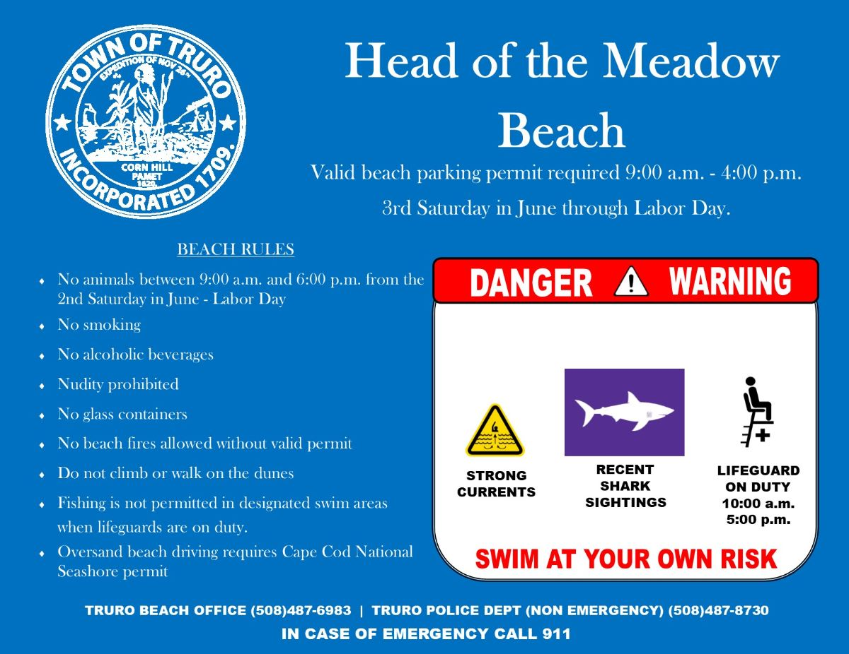
New Main Entrance Beach Signs

Slide 10
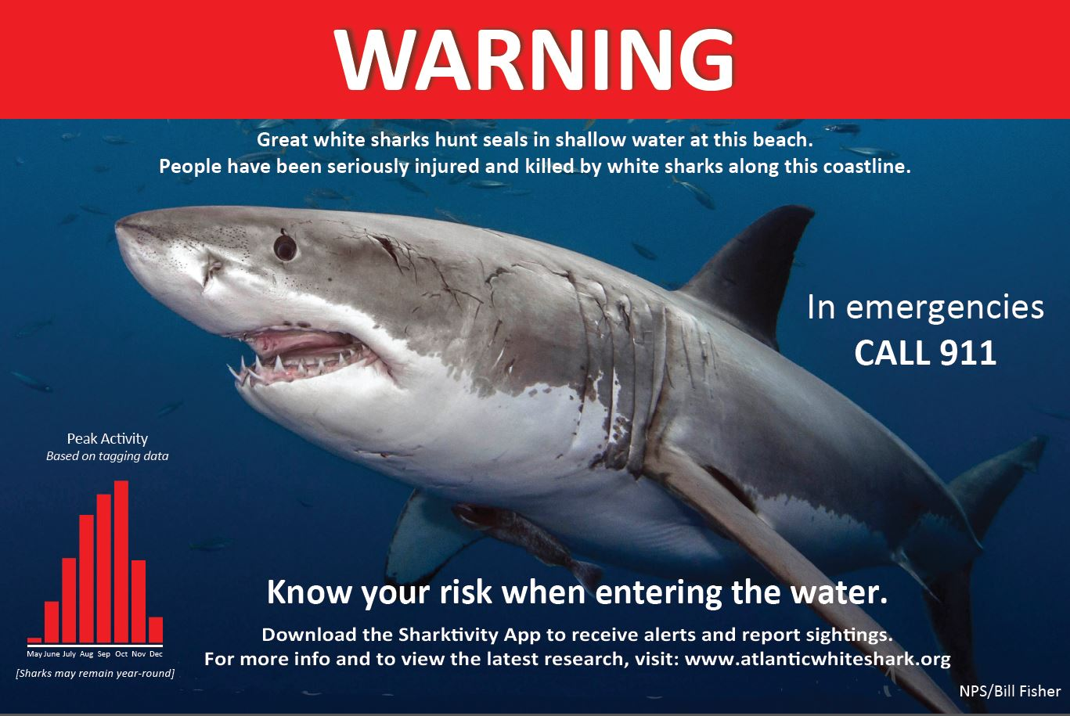
New Shark Signs at Ocean Beaches

Slide 11
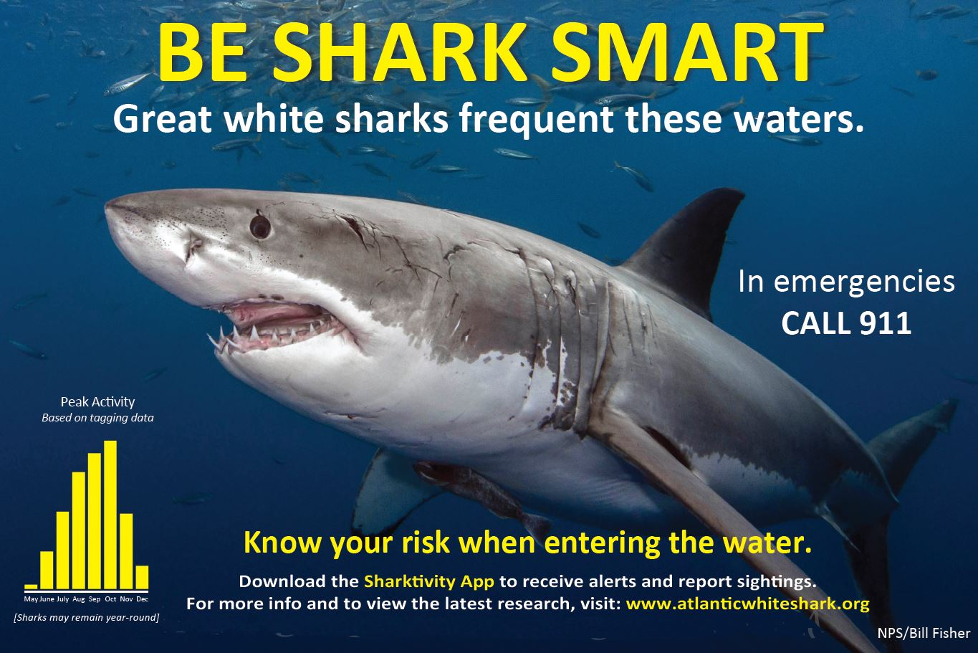
New Shark Signs at Bay Beaches

Slide 12

New Brochures (Side 1)

Slide 13
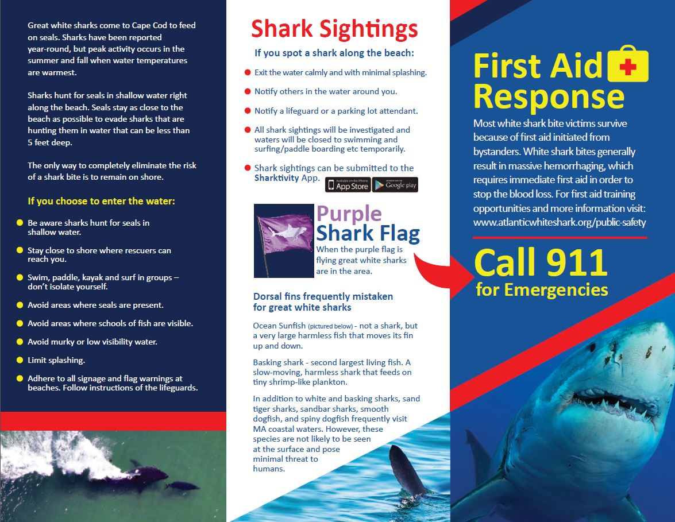
New Brochures (Side 2)

Slide 14
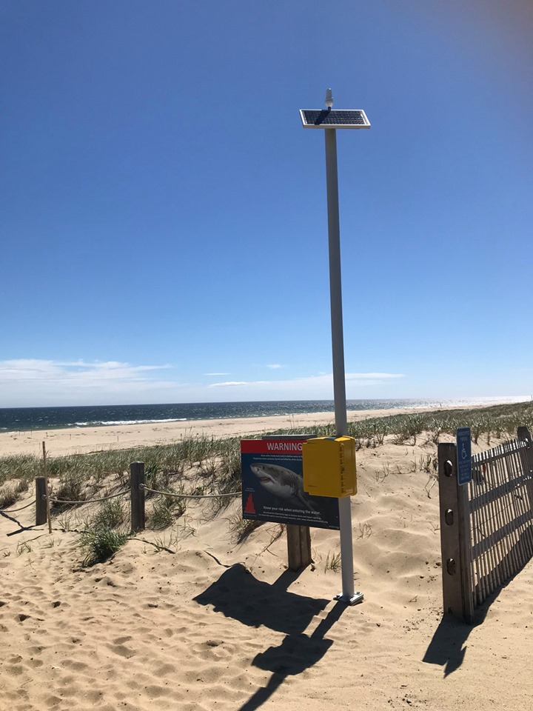
Fall 2018- Present Shark Preparedness Efforts
Communications
        Satellite call boxes installed at Ballston, Long Nook, Coast Guard, Head of the Meadow and Corn Hill*
        Portable satellite phones for beach and rescue staff to communicate on the beach*
        In vehicle repeaters* and public safety radio upgrades
        *Paid for with State funding
Satellite call box installed before Memorial Day Weekend at Head of the Meadow

Slide 15
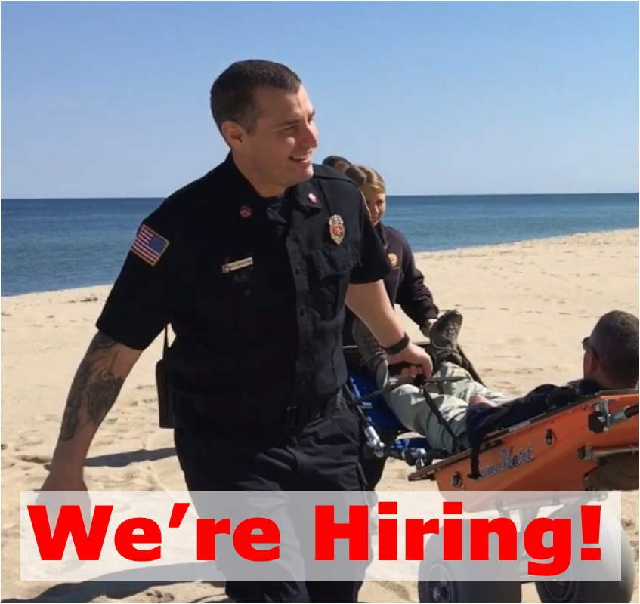
Fall 2018- Present Shark Preparedness Efforts
Medical Response
        Purchase of a Utility Task Vehicle (UTV)
        Purchase/packing of Hemorrhage Control Kits similar to those that CCNS packs. Installation will be at all Town beaches. More robust kits will be carried by rescue staff and lifeguards.*
        Seasonal Beach EMTs—new program modelled after similar program in Orleans
        Stop the Bleed trainings: Fire Department continues to provide “Stop the Bleed” trainings.
        Soft-turf Beach Stretchers*
        *Paid for with State funding
New Seasonal Beach EMT Program will rove beaches

Slide 16
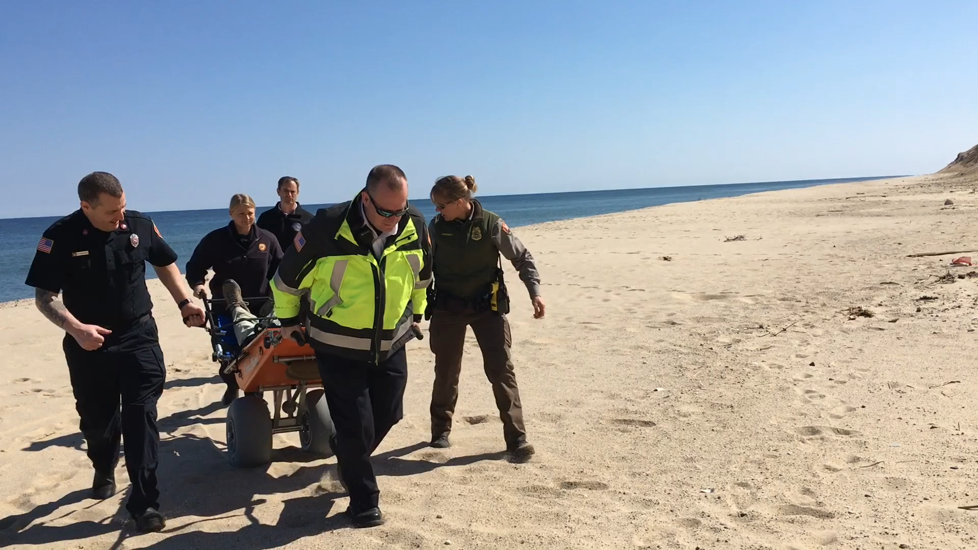
EvacCart (Beach Stretcher) Demo

Slide 17
Fall 2018- Present Shark Preparedness Efforts
Research
        Shark Mitigation Alternative Analysis—regional study conducted by Woods Hole Group
        Other potential studies

Slide 18
What Still Needs to Be Done
Cellular coverage expanded to all beaches
Future radio system upgrade
Results from the Woods Hole Group Shark Mitigation Alternatives Analysis expected in fall 2019
Expanded shark research

